Slide 1


High Performance Cluster Computing
Architectures and Systems
Hai Jin
Internet and Cluster Computing Center

Slide 2
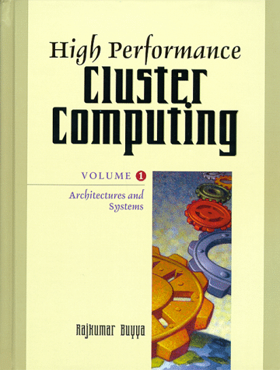
High Speed Networks
  Introduction
  Design Issues
  Fast Ethernet
  High Performance Parallel Interface (HiPPI)
  Asynchronous Transfer Mode (ATM)
  Scalable Coherent Interface (SCI)
  ServerNet
  Myrinet
  Memory Channel
  Synfinity

Slide 3
Introduction
Network is the most critical part of a cluster
Its capabilities and performance directly influences the applicability of the whole system for HPC
Starting from Local/Wide Area Networks (LAN/WAN) like Fast Ethernet and ATM, to System Area Networks(SAN) like Myrinet and Memory Channel

Slide 4
Choice of High Speed Networks (I)
Fast Ethernet
  100 Mbps
  CSMA/CD (Carrier Sense Multiple Access with Collision Detection)
HiPPI (High Performance Parallel Interface)
  copper-based, 800/1600 Mbps over 32/64 bit lines
  point-to-point channel
ATM (Asynchronous Transfer Mode)
  connection-oriented packet switching
  fixed length (53 bytes cell)
  suitable for WAN
SCI (Scalable Coherent Interface)
  IEEE standard 1596, hardware DSM support

Slide 5
Choice of High Speed Networks (II)
ServerNet
  1 Gbps
  originally, interconnection for high bandwidth I/O
Myrinet
  programmable microcontroller
  1.28 Gbps
Memory Channel
  800 Mbps
  virtual shared memory
  strict message ordering
Synfinity
  12.8 Gbps
  hardware support for message passing, shared memory and synchronization

Slide 6
Evolution in Interconnect Trends
Computational capacity vs. network bandwidth
Computing power was the bottleneck in the past. But the communication is the bottleneck
Simplicity, bus based -> complicated technology, switch based
Ethernet
  popular, easy to accommodate new technology
  distance, speed, limited bandwidth
High speed networking
  Giga bps, distance (optical media) etc...

Slide 7
Design Issues
Goals
  price/performance trade off
General Architecture
  low design effort, free from processor
Design Details
  simple, fast, pipelining
  low start-up latencies, good overall throughput

Slide 8
Goals (I)
Price vs. Performance
  production volume, expensive physical layer, amount of storage
  Fast Ethernet($50-100) vs. Myrinet or ServerNet ( $1000 or more )
Scalability
  fixed topology vs. dynamic topology, shared media vs. private media
  traditionally fixed network topology (mesh, hypercube)
  clusters are more dynamic
  network can tolerate the increased load and deliver nearly the same bandwidth latency
  can afford arbitrary number of nodes

Slide 9
Goals(2)
Reliability
  CRC check level/provider, buffering storage for retransmission, protocol complexity
  two classes of parallel computer
    scientific and business computing
  can operate itself without software overhead
    error freed physical layer
    CRC can be computed by NI itself
    error signaling (interrupt or status registers)
    NI side buffer

Slide 10
General Architecture (I)
Shared Memory vs. Distributed Memory
  convenience vs. cost
  shared memory model - transparency
    DEC’s Memory channel and SCI
    virtual memory management
      cache coherent ( write and invalidate ) -> overhead
    small scale: manageable
  distributed memory model
    message passing
    send / receive API ( explicit )

Slide 11
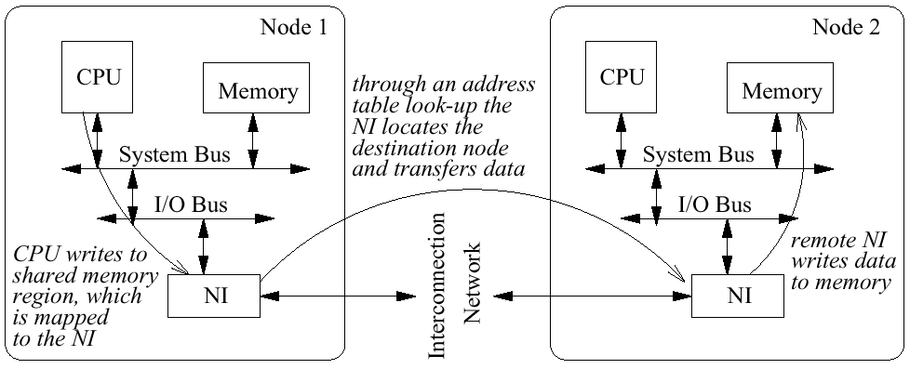
Write Operation to Remote Memory

Slide 12
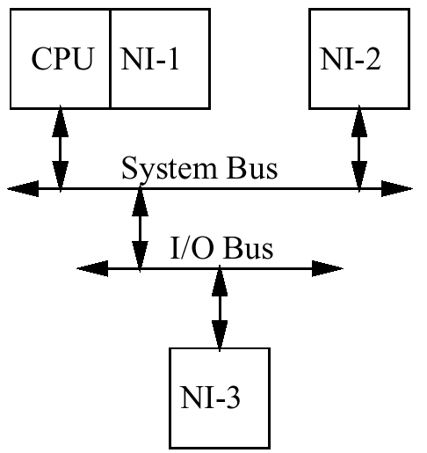
General Architecture (II)
NI location
  Critical to performance and usability
  NI1
    transputer, most implemented at the prototype phase
  NI2
    best place for NI, but proprietary system buses
  NI3
    most common today, no way to support cache coherence

Slide 13
General Architecture (III)
NI-1
  instruction set (special communication registers)
  Transputer from INMOS
  iWrap, related systolic architecture
  not successful ( too small market)
NI-2
  ideal (case of high performance bus)
  system bus based NI
  poll on cache-coherent NI registers
  DMA can read/write from/to main memory using burst cycle
  NI implementation only

Slide 14
General Architecture (IV)
NI-3
  PCI-based NI
  at any system w/ PCI I/O bus
  current PCI 32bit/33 MHz - potential bottleneck
  future 64bit/ 66MHz
  disadvantage of the I/O bus location is the loss of some properties such as cache coherence

Slide 15
Design Details (I)
Link Protocol
  used for layout of messages
  detect start/end
  signal event

Slide 16
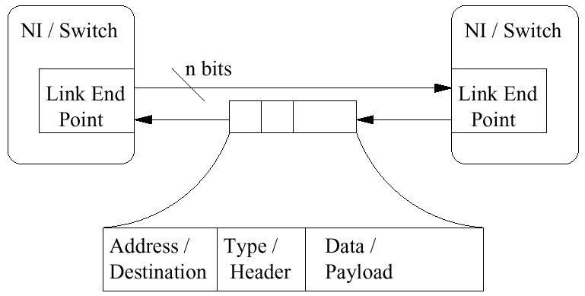
A Bidirectional Link and the General Message Format

Slide 17
Design Details (II)
Physical Layer
  choose physical medium (data rate, cost)
  serial medium - adequate standard link level transport layer (ex. Gbps Ethernet)
  64 bit wide cable (ex. HiPPI )
    high data rate
    pin count is limitation for the implementation
      8 x 8 unidirectional switch with 32 bit signal lines
      => 1024 pins for the link ( Too Much )
  bytewide link (ex. Myrinet or ServerNet)
    good compromise
    moderate size of switches and moderate speed
  optical layers will replace copper-base layers

Slide 18
Design Details (III)
Switching
  two main technique
    packet switching - traditional
      store/forward operation => limit packet’s characteristic
    wormhole switching - Myrinet
      forward if header is decoded
      low latency and small buffer size
      message size can be various
      but error correction is difficult

Slide 19
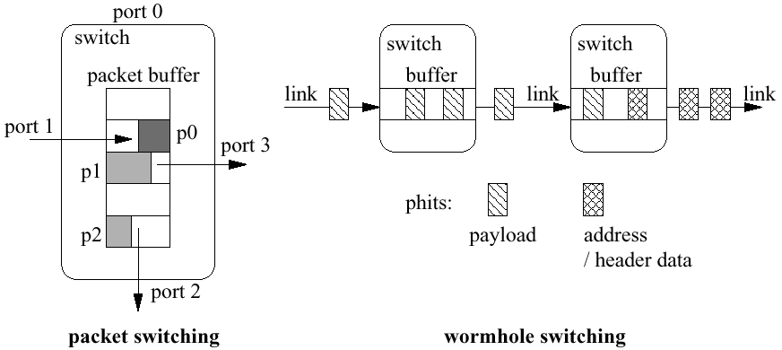
Switching Techniques

Slide 20
Design Details (IV)
Routing
  outgoing w/ contained address in header
  deterministic and adaptive routing schemes
  source-path and table-based routing

Slide 21
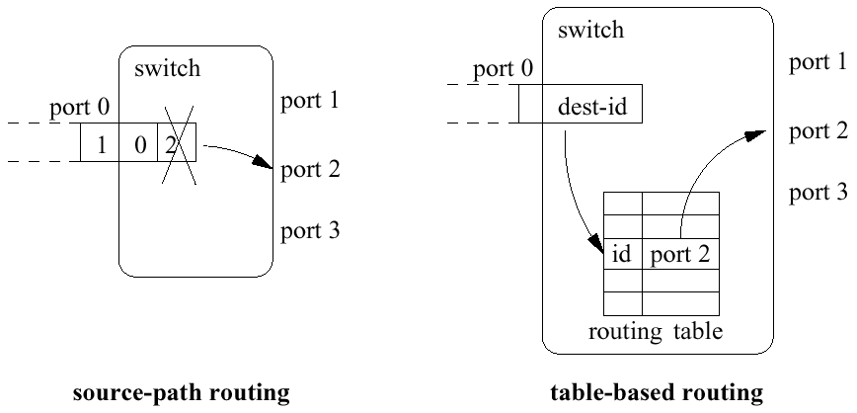
Routing Mechanisms

Slide 22
Design Details (V)
Flow Control
  avoid buffer overrun
  credit based schemes (get and consume)
    in case of Myrinet STOP and GO control bytes
  flow control signal travels in the opposite direction relative to the data
Error detection and correction
  very low error rate in physical level
  CRC
  software -> hardware
  so need not s/w CRC check => NI can do it !!

Slide 23
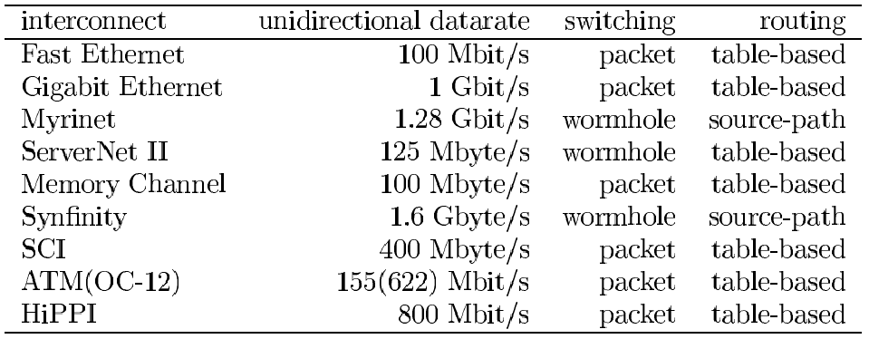
Link Parameters

Slide 24
Design Details (VI)
Data Transfer
  NI is critical
  user level operation to avoid the costs of OS call
  zero copy mechanism
    data is transferred to main memory directly
Programmed I/O vs. Direct Memory Access
  PIO
    processor copies data between memory and NI
    low start up times but inefficient as message size grows
  DMA
    network device itself initiate the transfer
    need a bit more: can swap anytime ? Is it running?
    DMA1 : data copy
    DMA2 : insert queue
    DMA3 : NI sets up a DMA transfer to read the msg data from memory

Slide 25
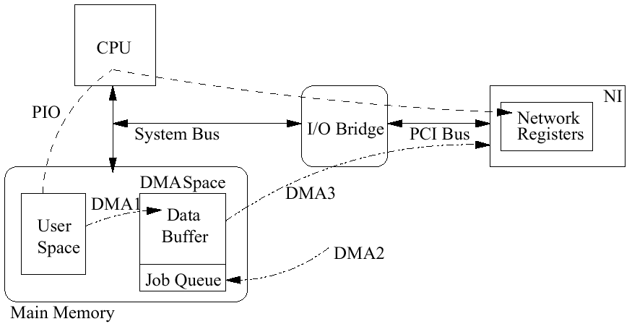
PIO versus DMA Data Transfer

Slide 26
Design Details (VII)
Several factors
  PIO: write message sequentially into a single NI register
    single bus cycles and poor bandwidth
    operate burst !!
  writing on consecutive address
    a special write buffer
    issued as burst transaction
  an instruction set support for cache control
    NI can read/write a large block of data
  PIO is superior to DMA for small message
    because of copy overhead

Slide 27
Design Details (VIII)
Polling vs. Interrupts
  case of DMA
    I/O bus NI - polling wastes a lot of bandwidth
    mirror NI status into main memory (cache-coherent memory)
    Interrupt - context switching overhead
    hybrid solution – programmable watchdog timer

Slide 28
Design Details (IX)
Collective operation
  sometimes need collective communication
  only few have direct communication
  broadcasting, multicasting, barrier synchronization
  cluster networks leave collective communication to software: tree-based algorithm
  case of shared bus system, easy to broadcast
    Myrinet or ServerNet is more complicate

Slide 29
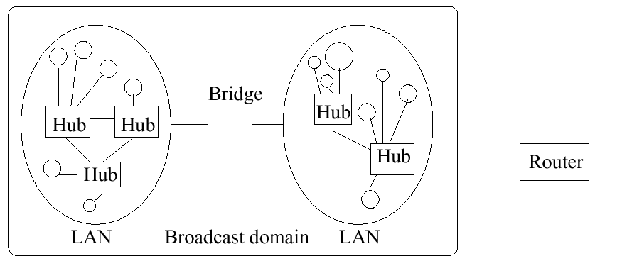
Fast Ethernet (I)
100 Mbps over UTP or fiber-optic cable
MAC protocol: CSMA/CD (Carrier Sense Multiple Access with Collision Detection)

Slide 30
Fast Ethernet (II)
Interconnection devices
  Repeater
    restore data and collision signal
    amplify and regenerate signals
  Hub
    central point
    repeat and copy: All can see it
  Bridge
    link adjacent LANs: datalink layer
    filtering
    forward to other segment
  Router
    link adjacent LANs: network layer
    shortest path

Slide 31
Fast Ethernet Migration
Replacement of hubs with Ethernet switches
Fast Ethernet repeater is the perfect complement to a LAN growth strategy

Slide 32
High Performance Parallel Interface (HiPPI) (I)
Designed to facilitate high speed communication between very high speed computers, & thereby to attempt to meet their I/O requirements
Designed to be a rapid mover of data, as well as a very implementable standard
An efficient simplex point-to-point link using copper twisted pair cable for distance of up to 25m
Standard capable of transferring data: 800Mbit/sec over 32 parallel lines or 1.6Gbit/sec 64 parallel lines

Slide 33
High Performance Parallel Interface (HiPPI) (II)
HiPPI standard
  HiPPI-PH
    the mechanical, electrical, & signaling of HiPPI physical layer
    support only a single point-to-point connection
  HiPPI-FP
    packet format and content (including header)
  HiPPI-SC
    allow a switching mechanism to be built which could allow multiple simultaneous point-to-point connections to occur
HiPPI drawbacks
  does not provide a complete, general purpose solution
  a collection of multiprocessors and management systems are needed without sacrificing HiPPIs data transfer speed or efficiency
  max 25 m distance between nodes -> serial HiPPI, SONET extension -> storage problem
  # of connection is restricted due to the SC complexity

Slide 34
HiPPI (III)
HiPPI-SC (Switch Control)
  HiPPI-PH: only single point-to-point
  alleviate the number of connections (but not final solution)
  switch grows O(n²)
  linearly connect up to 50-pair within 25 m
Serial HiPPI
  overcome 25m distance (HiPPI-PH, standard 50-pair )
  Gigabit dark fiber optics and copper coaxial
  increase the turn around time
  latencies are hidden (only show connected or not )

Slide 35
HiPPI (IV)
High Speed SONET Extensions
  HiPPI extender using SONET’s STS-12s
    create a set of terminal devices
    place STS-12c payload for transmission
    convert it back to HiPPI
    lay out PLCP (Physical Layer Convergence Protocol) which maps HiPPI bursts into STS-12c rows
  Rely on large RAM in the down-link extender
    2 x bandwidth x delaybytes
  Features
    HiPPI to SONET interface implemented completely in hardware
    4 Mbyte of RAM of data buffering (on the down-link side)
    64 bit CRC transmitted with each STS-12c frame
    An i960 RISC-based microprocessor is included for supervisory functions and monitoring

Slide 36
HiPPI (V)
HiPPI Connection Management
  Centralized
  Broadcast: policies upon shared knowledge
  Distributed: no explicit knowledge (random wait and retrying methods)
HiPPI Interface
  Used primarily as a high speed networked data channel between computer systems & supercomputers
  Full duplex and direct connection with another HiPPI interface or conjunction of HiPPI
  Various HiPPI interfaces available
    VME-HiPPI, SBUS, PC and workstation standard, special interfaces used in CRAY computers

Slide 37
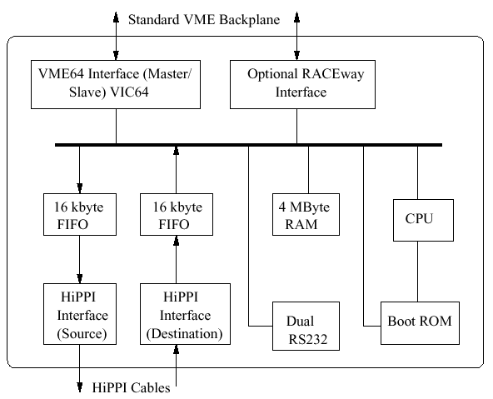
VME64 HiPPI Interface Block Diagram

Slide 38
HiPPI (VI)
Array System: The HiPPI Interconnect
  distributed memory multiprocessor
  100 or more MIPS processors in as many as 8 POWERnode
  peak aggregate computing capacity in excess of 50 GFLOPS
  HiPPI switch is nonblocking with sub-microsecond connection delays

Slide 39
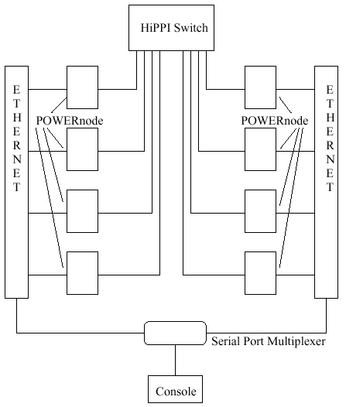
Array System Schematic

Slide 40
Asynchronous Transfer Mode (ATM) (I)
Offer significantly greater bandwidth, flexibility, & QoS service support
Consist of ATM switches, ATM routers, & LAN switches
Connection oriented packet switching
Highly suitable for wide area LAN and WAN
ATM routers and LAN switches are more effective
Huge bandwidth
  cost effective to transfer large quantities of data
Not so good for cluster computer interconnection
  hardware cost
  not good performance in LAN
  effective in supporting clusters over WAN

Slide 41
ATM (II)
Concepts
  VCI ( Virtual Circuit Identifier)
    information to be carrier over the network is broken up into blocks (cells) with an identifying label called VCI
    VCI is attached to each block
    VPI (virtual path identifier): group of VCIs
  Multicast Virtual Circuit
    used to transfer info from a single source to several recipients
    replication and forwarding (switching system)
  Switched virtual circuit (SVC) vs. Permanent virtual circuit (PVC)
    SVC: automatically set up by ATM signaling & flexible a fast connection setup time of 10 ms
    PVC: manually setup for leased lines applications

Slide 42
ATM (III)
Concepts
  ATM Adaptation Layer (AAL)
    support many kinds of services
    Four types of AAL
      AAL1: support connection-oriented services that require constant bit rates services and have specific timing and delay requirements
      AAL2: support connection-oriented services that do not require constant bit rates, but service variable bit rate applications
      AAL3/4: for both connectionless and connection-oriented variable bit rate services
      AAL5: support connection-oriented variable bit rate services

Slide 43
ATM (IV)
ATM Adapter
  FORE system
    embedded Intel i960 RISC
    AAL5 and 3/4 Segmentation and Reassembly (SAR)
    scatter-gather DMA

Slide 44
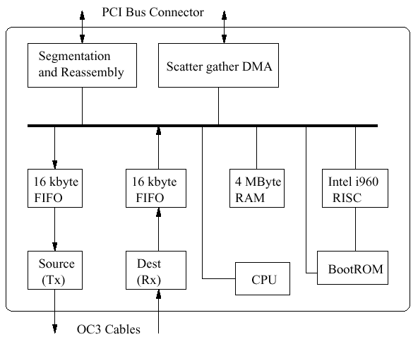
Block Diagram of ATM Adapter

Slide 45
ATM (V)
ATM API Basics
  SAP(Service access point )
    ATM Address, ATM selector, Broadband low layer information (BLLI), and Broadband high layer information (BHLI)
    [ATM address, ATM Selector, BLLI id2, BLLI id3, BHLI id]
      BLLI ids: layer 2 protocol
      BHLI id: application layers
    SAP vector element (SVE): tag, length, and value field

Slide 46
ATM (VI)
Performance Evaluation of ATM
  Hardware
    4 Sparc Sun workstations with 10 Mbit/s Ethernet adapter and a Fore system ATM adapter connected to a Fore system ASX-200 ATM switch
  PDE (parallel differential equations )
    parallel matrix multiplication
    promising over local network
    acceleration may be considered

Slide 47
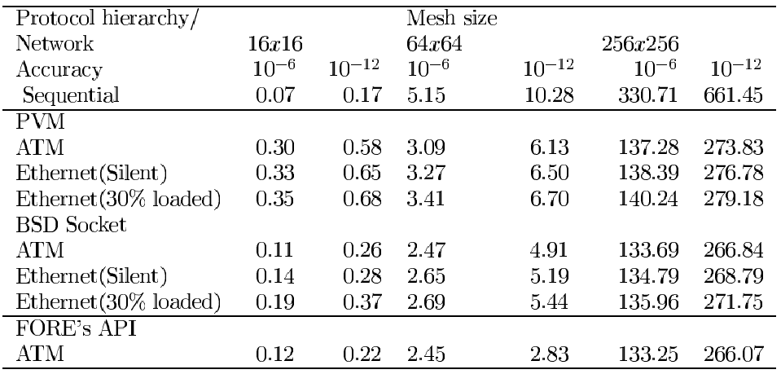
Execution Time (sec) of Partial Differential Equation

Slide 48
ATM (VII)
Issues in Distributed Networks for ATM Networks
  Resource management
    data rate can adapt to data traffic and available network availability
    peak rate leads to significant inefficiency
  Multicast routing
    a greedy algorithm
      add new endpoints using a shortest path from the endpoint to the connection
      delete endpoints by pruning the branch needed only by the endpoint being dropped

Slide 49
Scalable Coherent Interface (SCI) (I)
A recent communication standard for cluster interconnects
Effectively a processor memory & I/O bus, high performance switch, local area network, & optical network
An info sharing & info communication system that provides distributed directory-based cache coherency for a global shared memory model & uses electrical or fiber optic point-to-point unidirectional cables of various widths
A single address space is used to specify data as well as its source & destination when transported
200 Mbyte/s (CMOS) to 1000 Mbyte/s (BiCMOS) over distances of tens of meters for electrical cable & kilometers for serial fibers

Slide 50
SCI (II)
Data transfer via SCI
  can interface with common buses such as PCI, VME, etc, & to I/O connections such as ATM or Fiber Channel
  8000 Mbps
  Usual approach of moving data
    When the data arrive at the destination, hardware stores them in a memory buffer and alerts the processor by an interrupt when a packet is complete or the buffers are full
    Software then moves the data to a waiting user buffer
    User application examines the packet to find the desired data
  Cache coherence scheme is comprehensive & robust
    independent of the interconnect type or configuration
    can be handled entirely in HW
    provide distributed shared memory with transparent caching that improves performance by hiding the cost of remote data access
    eliminate the need for costly SW cache management

Slide 51
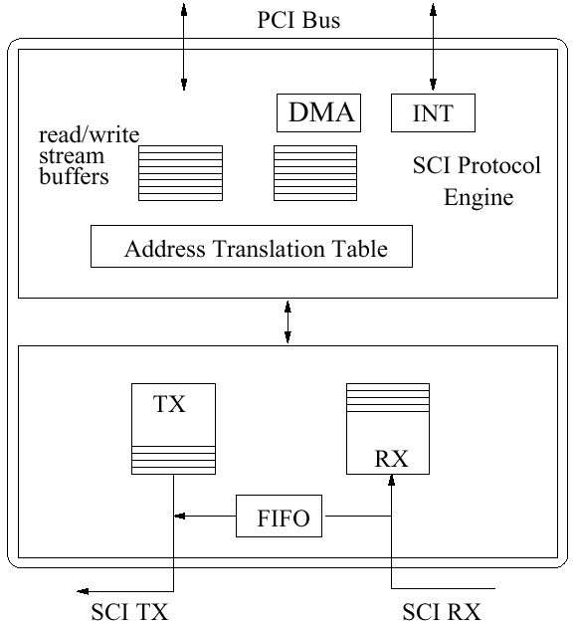
Block Diagram of the Dolphin PCI-SCI Bridge

Slide 52
SCI (III)
Advantages of SCI
  reduce the delay of interprocessor comm by an enormous factor
    SCI eliminates the need for runtime layers of SW protocol-paradigm translation
  most useful for clustering over local area distance or less
    least suitable over long distance
  remote communication is opcode
  remote address cache miss => get from data
  performing all the network protocol as a fraction of one instruction
  distributed cache-coherent mechanism
  simple - efficient with large blocks of data
    but lots of handshaking and heavy traffic
  each interface chip can handle active packets concurrently ( flight awaiting )

Slide 53
ServerNet (I)
The first commercially available implementation of a SAN in 1995 by Tandem, now supported by Compaq
ServerNet II in 1998
  raise the bandwidth & add new features
Intend to provide high bandwidth, scalable, and reliable interconnect between processors and I/O devices required by HPC applications, but turned quickly into a general purpose SAN
125Mbyte/sec bandwidth between two nodes in a clustered system

Slide 54
ServerNet (II)
Scalability and reliability as main goal
  consist of endnodes & routers
  endnodes with interface to the system bus or various I/O interfaces
  routers to connect all endnodes to one clustered system
Ability to transfer data directly between 2 I/O devices, thus relieving processors of plain data copy jobs (zero copy)

Slide 55
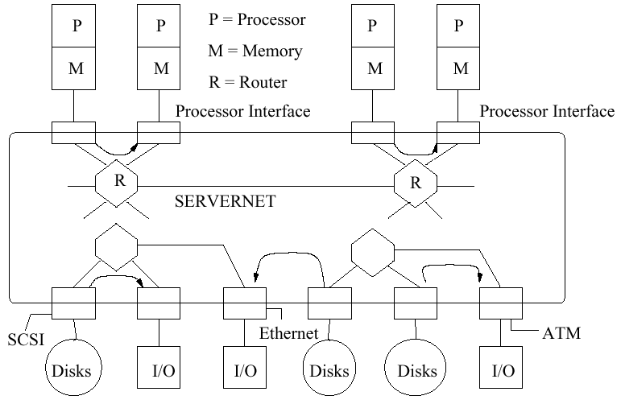
A Sample ServerNet Configuration

Slide 56
ServerNet (III)
ServerNet Links
  full duplex, wormhole switched network
  1st version: 9 bps , 50MHz
  2nd version: 125MByte/s
  serial copper cable => longer distance
  with additional converter, ServerNet I and II components can be mixed within one system
  operate asynchronously and avoid buffer overrun through periodic insertion of SKIP control symbols, which are dropped by the receiver

Slide 57
ServerNet (IV)
Data transfer
  DMA-based remote memory read/write
  endnode: 64 (512 in ServerNet II) byte from/to a remote memory
  check read/write permissions
  (advance) specify one of several packet queues

Slide 58
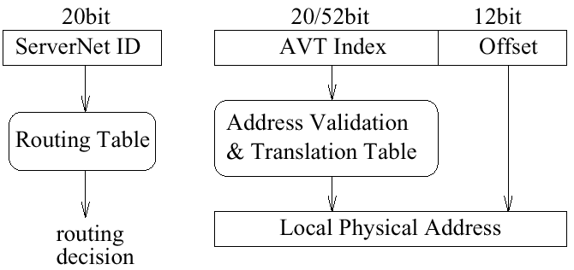
ServerNet Address Space

Slide 59
ServerNet (V)
Fault Tolerance
  support guaranteed & error free in-order delivery of data on various levels
  check validation at each stage
  sending acknowledge
Switches
  1st: 6 port switches, 2nd: 12 ports
  separate the data channel and control channel
  ability to form so called Fat Pipes
    Several physical link can be used to form one logical link and choose dynamically

Slide 60
ServerNet (VI)
Driver and Management Software
  low overhead protocol layers and driver software
  mechanism to efficiently support the message passing model of the VIA
  IBC (In Band Control): same links as normal data packets
  IBC protocol is responsible for initialization, faulty node isolation and several other management issues
  IBC packets are used to gather status or scatter control data to all ServerNet components

Slide 61
ServerNet (VII)
Focus on the business server market, poorly accepted by researchers so far
A lot of properties, extremely useful for cluster computing
  error handling on various levels
  a kind of protection scheme (AVT)
  standard physical layers (1000BaseX cables)
  support for network management (IBC)
Will be one of the leading SANs
  several companies will use ServerNet for their servers & clusters
  considerable influence on the VIA specification

Slide 62
Myrinet (I)
A SAN evolved from supercomputer technology
A main product of Myricom (founded in 1994)
Quite popular in the research community
  all HW & SW specifications are open & public
Based on 2 research projects
  Mosaic by Caltech
    a fine grain supercomputer, need a truly scalable interconnection network with lots of bandwidth
  Atomic LAN by USC
    based on Mosaic technology, a research prototype of Myrinet
Speed: 1.28 Gbps
Good price/performance ratio

Slide 63
Myrinet (II)
Host interface
  LANai chip
    a custom VLSI chip, a programmable microcontroller
    control the data transfer between the host & the network
  SRAM memory
    Message data must first be written to the NI SRAM, before it can be injected into the network
  (+) the great flexibility of the HW due to a programmable microcontroller,
  (-) but can also be a bottleneck with respect to performance since the LANai runs only at moderate frequencies

Slide 64
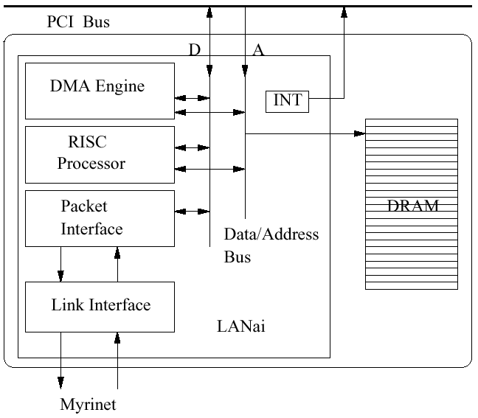
Myrinet Host Interface

Slide 65
Myrinet (III)
Link and Packet Layer
  similar ServerNet
  full duplex 9 bit parallel channel in one direction running at 80MHz
  network offer 160Mbyte/s physical bandwidth over one channel
  two different cable type (SAN, LAN)
    3m SAN link, 10m LAN link
  variable length data format
  route with wormhole switching
  source path routing
  consist of routing header
  special control symbols (STOP, GO)

Slide 66
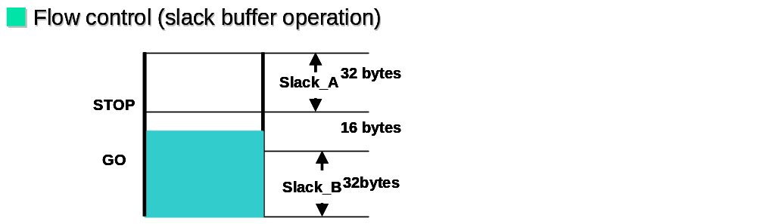
Flow Control
(Slack Buffer Operation)

Slide 67
Myrinet (IV)
Switches
  4, 8 and 16 ports, mixable SAN and LAN
  any network topology
  autodetect the absence of a link
  starting up, host interface detect network topology automatically
Error Handling
  MTBF: million hours are reported
  cable fault and node failure
    alternative routing by LANai
  prevent deadlock: time out generates a forward reset (FRES) signal

Slide 68
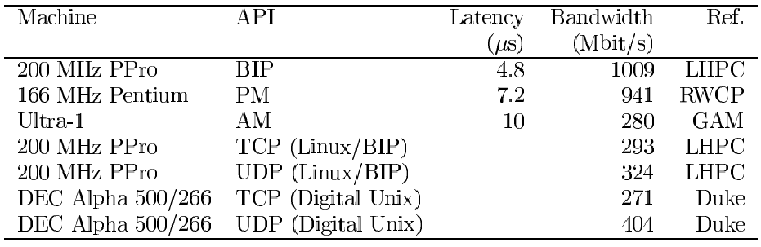
Performance of Message Layers over Myrinet

Slide 69
Memory Channel (I)
A completely different approach towards SANs
Provide a portion of global virtual shared memory by mapping portions of remote physical memory as local virtual memory
Obtained from Encore & several other projects such as VMMC or SHRIMP
Speed: 800 Mbps

Slide 70
Memory Channel (II)
client
client
. . .
client
Ethernet
Adapter
Ethernet
Adapter
. . .
SCSI BUS
SCSI
Controller
SCSI
Controller
. . .
Shared
Disk
Shared
Disk
Memory Channel
Adapter
Memory Channel
Adapter
Memory Channel(MC)

Slide 71
Memory Channel (III)
Bringing Together Simplicity and Performance
  consist of a PCI adapter & a Hub
  1st version: shared medium => bottleneck
  2nd version: point-to-point, full-duplex 8x8 cross bar
  heartbeat signal and flow control
    detect node failure or blocked data transfers

Slide 72
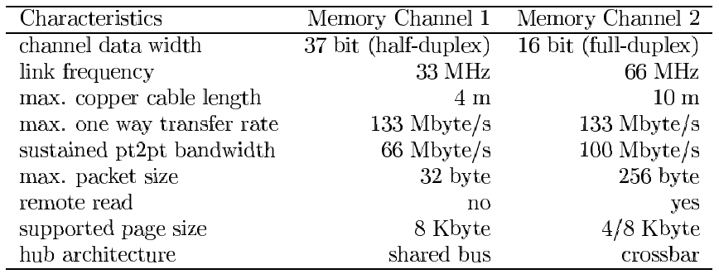
Comparison of Memory Channel 1 and 2

Slide 73
Memory Channel (IV)
Data Transfer
  Map pages as read- or write-only into virtual address space
  Read-only page: a page is pinned down in local physical memory
  Write-only: page table entry is created in PCI interface
    store a local copy of each packet
    request acknowledge message from receiver
    define the packet as broadcast or point-to-point packets

Slide 74
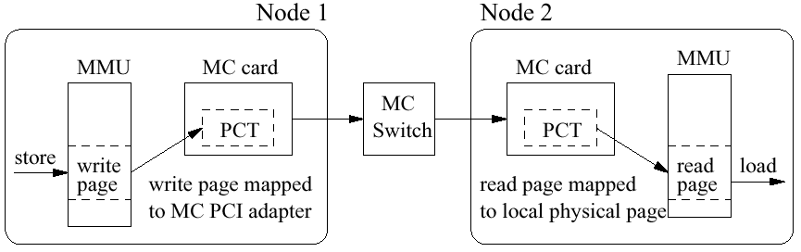
Data Transfer over Memory Channel

Slide 75
Memory Channel (V)
Software and Performance
  Memory Channel and UMP(Universal Message Passing)
    MPI, PVM, HPF
    Alpha 4100 nodes (300 MHz 21164 CPU) in a two node configuration
  Reduce communication to the minimum: simple store operations
    latencies for single data transfers are very low
      One way latency for an 8 byte ping-pong test: 2.2μs (raw), 5.1 μs (HPF) and 6.4 μs (MPI)
    reach the max sustained datarate of 88 Mbyte/s with relative small data packets of 32 byte
  Largest possible configuration
    8 12-CPU Alpha server nodes: a 96-CPU cluster

Slide 76
Synfinity (I)
Developed & marketed by Fujitsu System Technologies (FJST)
  a business unit of HAL computer Systems & Fujitsu
  based on the technology of HAL’s Mercury interconnect
Support both parallel programming models: Message Passing & Shared Memory
3 components
  Synfinity NUMA
    an adapter to connect SMP nodes together to one ccNUMA cluster
  Synfinity CLUSTER
    a host adapter intended for Message Passing
  Synfinity NET
    a six-port switch to connect several interfaces together to 1 cluster

Slide 77
Synfinity (II)
Pushing networking to the technological limits
  Synfinity NUMA
    with Xeon processor, forming ccNUMA
  CLUSTER interface
    32/64 bit , 33/66MHz available
    PMB (PCI to Mercury Bridge) and MIC (Mercury Interface Chip)

Slide 78
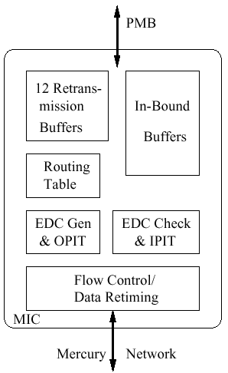
Synfinity Mercury Interface Chip (MIC)

Slide 79
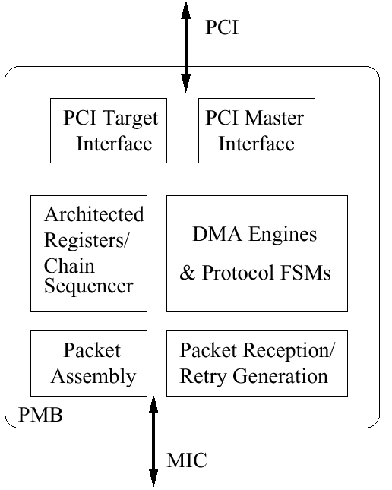
Synfinity PCI to Mercury Bridge (PMB)

Slide 80
Synfinity (III)
Data Transfer
  various data transfer and communication services
  Plain Send/Receive
  Put/Get
  RMW (Remote Atomic Read Modify-Write)
  choose Fetch/Add or Compare/Swap
  special barrier
  Initiated chained descriptors
  credit-based mechanism
  Bust/Retry acknowledge

Slide 81
Synfinity (IV)
Switches
  6port, virtual cut-through switch (200MHz)
  64 nodes in an arbitrary topology
  Source-path routing
  To prevent blocking of small special-service packets, 3 arbitration priorities allow small message to bypass large Put/Get packets

Slide 82
Synfinity (V)
Software is available as a VIA implementation under Window NT
  220 Mbyte/s bandwidth on a 64 bit/66 MHz PCI Sun Ultra
Looks good for message passing system
Several communication mechanism directly supported in hardware
  enables thins and fast protocol layers
Advanced Flow control in heavy load is very interesting

Slide 83
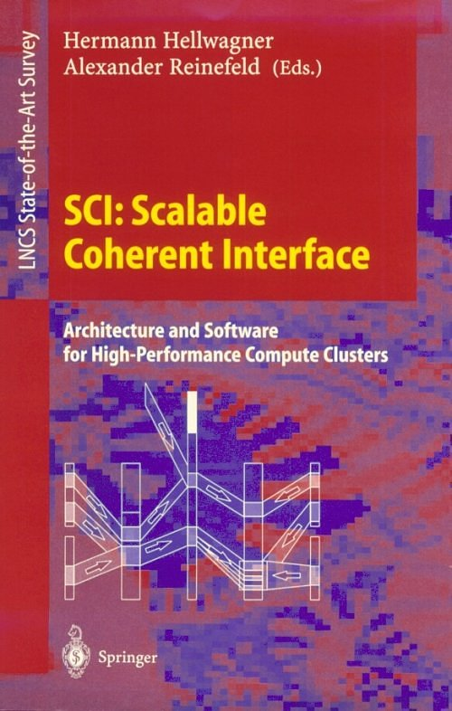
Reference Book

